Slide 1
Chain News Monitoring

Slide 2
Supply Chain Due Diligence Act
Act should reduce human right violations within global supply chains
Medium and large companies in Germany will be accountable and must act upon for violations that happen anywhere in their supply chain
Breaking the law can lead to penalties up to 2% of yearly revenue.

Slide 3
Features of the News Monitor
Discover and assess new sources of news articles, ensuring global coverage.
Identify violations or possible violations that may require actions
Identify relevant locations in article
Efficient storage and data retrieval
3000+ sources being evaluated daily through automated scraping
Efficient classification method to remove clearly irrelevant articles, with high recall
Fast location extraction to determine news coverage
REST-API framework for access to processed sources and locations
Notes:
To realise such a system, we identified 4 main components for the system
Retrieval and Storage: for downstream tasks the data is accessible through the Api.

Slide 4





Results
3.5M+ Articles Scrapped
3.8k News sources
45 languages translated
News covering 158 countries
200k+ Relevant articles
Notes:
Lang detect is at times faulty recognising english as other languages
But it is fine as its being

Slide 5
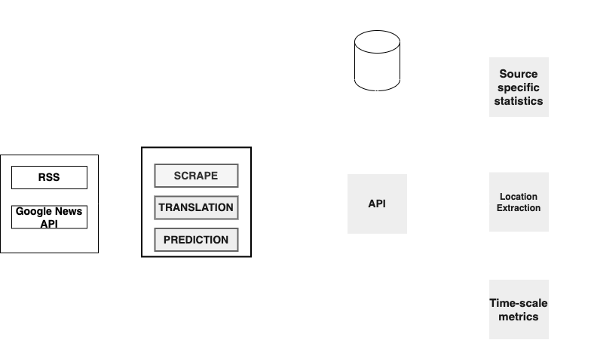
Architecture Overview
Notes:
For extracting new news sources: we utilise RSS feeds and Google News API, which searches news based on keywords.
In the preprocessing pipeline: we have a general scraper for robustly scraping the sources.
Translation is performed on sources which are not in english.
Finally after processing, we feed this data to the classifier to mark the relevance of the article
Processed data is then stored into a Relational DB using the API
For downstream tasks: we use the API to output news source metrics, required to identify new relevant news sources. Location data, detailing the news coverage of our system.

Slide 6
Source Discovery

Slide 7
Identifying news sources
Aim: to identify new sources with high proportion of articles on law violations
We monitor this through two channels:
RSS feeds from Blog.feedspot
Google news extracted through keyword search
Scraped articles are classified to determine relevance
Source relevance is assessed based on the proportion of articles classified as relevant

Slide 8
RSS Feed scraper
Uses multiple approaches: Feedparser and BeautifulSoup
Feedparser handles standard RSS schema
BeautifulSoup for handling variations in schema names.
Timestamp : published, date
URL : Source, Link, RSS
Custom date parser to store dates in UNIX format.
06-09-2022 , 06/09/22
06 Sep 2022, September 06 2022
20220609
Lookback period of 5 days to avoid duplicate scraping and translation
Notes:
Feedparser: only handles standard RSS feed schema
BeautifulSoup where the schema is irregular (field name are different ts, published)
Duplicates: feeds updated every month or 2 weeks

Slide 9

Google News Articles
Keyword-based news search
Keywords are identified using the most frequently occurring words in the gold standard data.
Query the google news website using individual keywords
Custom parser for converting standard format
No content and source information available.
Google news RSS link is stored as the source instead.
More targeted search has led to higher hit rates
Notes:
Keywords: human intervention, and stopword removal
Duplicates: feeds updated every month or 2 weeks

Slide 10
Preprocessing

Slide 11
Translation
Initially Google Cloud Translate API was used
Due to credit limitations, we moved to ensemble of open-source translation APIs to get coverage for majority languages.
Transformer-based models were considered, but models were language specific or too large (> 5GB) for our use case.
Before translation we perform language detection for improving accuracy of translation.

Slide 12
Preprocessing - Classifier
Preprocessing
Doc2Vec
PCA
Logistic Regression w/w Boosting
Prediction
Model | Recall | Precision | F1-score
Baseline | 0.36 | 0.04 | 0.07
XG-boost w/w Meta-Cost @r=5, m=50 | 0.10 | 0.53 | 0.17
Support Vector Classification (SVC) | 0.72 | 0.05 | 0.09
SVC w/w Meta-Cost | 0.98 | 0.02 | 0.04
LR w/w Boosting, n=30 embeding_dim = 300 + PCA | 0.80 | 0.09 | 0.17
LR w/w Boosting, n=30 embeding_dim = 300 + PCA * | 0.88 | 0.17 | 0.28
Notes:
We defined the model’s purpose to be an efficient, coarse filter to remove obviously irrelevant articles. Therefore, we require a high recall score, to avoid missing relevant articles
Embeddings are created using Google News Vectors. From Google News we obtain word2Vec embeddings. To create document embeddings for the title and the content, we obtain the mean embeddings. Essentially a weighted average on the word frequency in the document.
The model itself perform binary classification. Given document features, the model outputs 1 if law violations are not mentioned else it predicts 0.

Slide 13
Storage - Articles
Following the processing data is fed into a relation DB instance.
Relevant Article table is created
Scheduled posting into the DB using the API.
Column | Description
id | GUID or URL of the article
ts | Timestamp
source | The link to the article
title | The title of the article
content | The content of the RSS feed
RSS | Link to the RSS feeds
label | Binary label for law violation

Slide 14
Location Extraction

Slide 15
Location Extraction
Location extraction is performed on all articles from relevant sources.
Identify hotspots and uncovered regions in the monitor.
We create 3 dictionaries for efficient lookup:
City
State
Country
Key | Description
Latitude | Latitude of the location
Longitude | Longitude of the location
Country | Country of the location
State | State of the location
City | City of the location
country_code | ISO-2 code of country
state_code | ISO-2 code of state

Slide 16
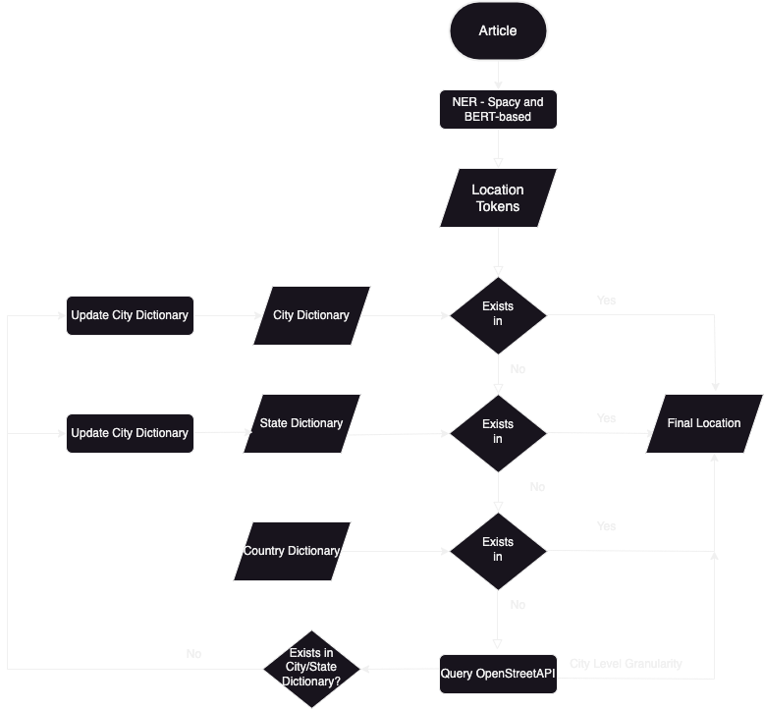
Location Extraction Algorithm
Notes:
Country dict is not updated
OpenStreetAPI only queried to city granularity
Also validates the locations, if incorrectly identified by the NER models.

Slide 17
Edge Cases and Limitations
Limitations | Mitigation
Countries and cities with same name Usa, Japan Uk, Russia | Removal from Cities dictionary
Multiple cities in same countries 16 Washingtons in United States alone | Output country itself, when state information is unavailable
Planets and Directions | Ignored
Single city present in multiple countries Hyderabad present in both India and Pakistan | Lookup state or country in tagged locations. If not present, the city is not tagged.

Slide 18
Storage - Locations
Column | Description
id | Counter variable
RSS | Link to the RSS feeds
ts | Timestamp
Latitude | Latitude of the location
Longitude | Longitude of the location
Country | Country of the location
State | State of the location
City | City of the location
country_code | ISO code of country
state_code | ISO code of state
Tagged locations are stored in the DB daily.
Locations table in the DB.
Raw data stored to article-level granularity.

Slide 19
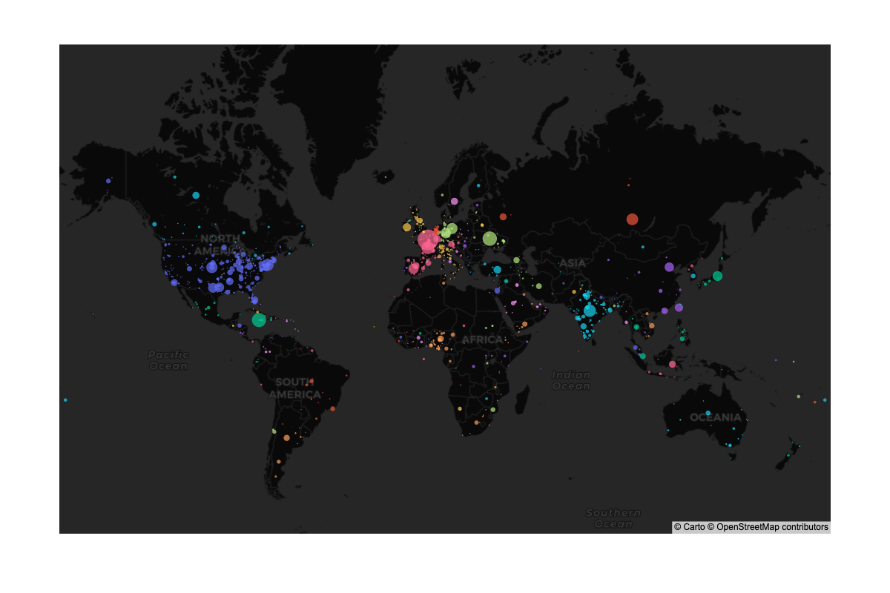
News Coverage

Slide 20
API

Slide 21
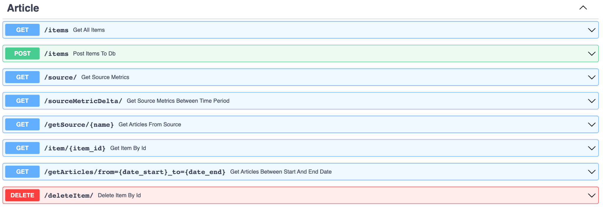
Endpoints - Source Metrics
Notes:
Basic CRUD operations
More relevant are the sourceMetricDelta which allows to determine the top feeds in the given time period
Opt parameters to filter by minimum number of total articles and min hit rate

Slide 22
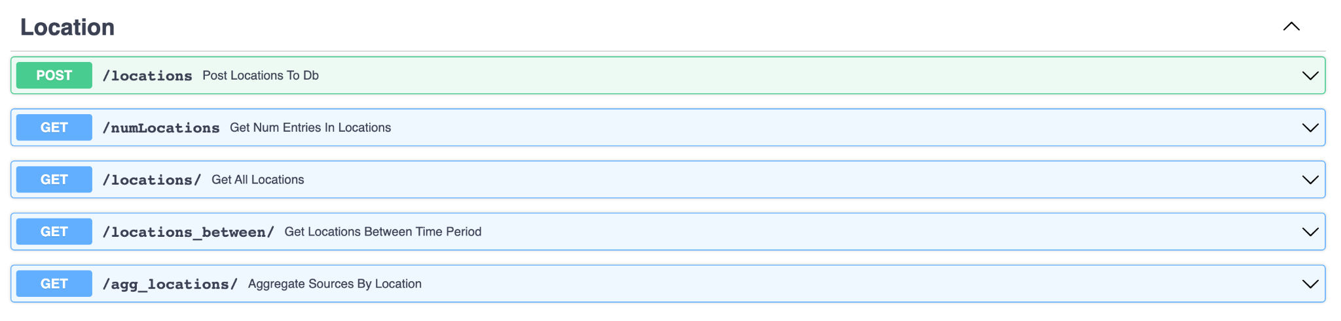
Endpoints - Location extraction
Notes:
Agg_locations: news coverage of model, counts for country and state level granularity

Slide 23
Next Steps
Article bundling
Online Learning - classification, and keyword identification
New news sources for under covered regions

Slide 24
Questions

